Slide 1
Name and Address Parsing
Presented by:
Dr. Talburt’s Team
US Address Data Preparation Function (UAP)
01
Date- Apr. 26, 2022

Slide 2
Name and Address Parsing
CONTENT:
Name and Address Parser Approach
Technologies Used
Steps in Name and Address Parsing
Step 1- Name and Address Parsing
What is Mask??
Example
Cleaning and Tokenizing
Getting the Tokens and Generating the Masks
Mask
Final Sub Step (Dictionaries)
Step 1 – Final
Step 2
Parsing
The Name and Address Parser is designed so that the user can easily segregate the names and addresses concerning the US Name and Address Format.
It also deals with those kinds of addresses that are not in a structured format.
Presented by:
Dr. Talburt’s Team
US Address Data Preparation Function (UAP)
02
Date- Apr. 26, 2022

Slide 3
Name and Address Parsing
CONTENT:
Name and Address Parser Approach
Technologies Used
Steps in Name and Address Parsing
Step 1- Name and Address Parsing
What is Mask??
Example
Cleaning and Tokenizing
Getting the Tokens and Generating the Masks
Mask
Final Sub Step (Dictionaries)
Step 1 – Final
Step 2
Parsing
Python (3.9)
JSON
Currently, we are using pure python and interacting with the JSON files for the input and the output as well
Presented by:
Dr. Talburt’s Team
US Address Data Preparation Function (UAP)
03
Date- Apr. 26, 2022

Slide 4
Name and Address Parsing
CONTENT:
Name and Address Parser Approach
Technologies Used
Steps in Name and Address Parsing
Step 1- Name and Address Parsing
What is Mask??
Example
Cleaning and Tokenizing
Getting the Tokens and Generating the Masks
Mask
Final Sub Step (Dictionaries)
Step 1 – Final
Step 2
Parsing
There is a kind of roughly 2 main steps in Name and Address Parsing
Name and Address Parsing
Exception Handling
Presented by:
Dr. Talburt’s Team
US Address Data Preparation Function (UAP)
04
Date- Apr. 26, 2022

Slide 5
Name and Address Parsing
CONTENT:
Name and Address Parser Approach
Technologies Used
Steps in Name and Address Parsing
Step 1- Name and Address Parsing
What is Mask??
Example
Cleaning and Tokenizing
Getting the Tokens and Generating the Masks
Mask
Final Sub Step (Dictionaries)
Step 1 – Final
Step 2
Parsing
This Step is responsible to split the name and addresses, and also generate its Masks
Confused??
Next Slide→
Presented by:
Dr. Talburt’s Team
US Address Data Preparation Function (UAP)
05
Date- Apr. 26, 2022

Slide 6
Name and Address Parsing
CONTENT:
Name and Address Parser Approach
Technologies Used
Steps in Name and Address Parsing
Step 1- Name and Address Parsing
What is Mask??
Example
Cleaning and Tokenizing
Getting the Tokens and Generating the Masks
Mask
Final Sub Step (Dictionaries)
Step 1 – Final
Step 2
Parsing
A mask is generally a Combination of individual tokens which are generated with the help of a Word Table.
Now a word table is generally a pipe-delimited file that has tokens, which contribute to generating the Masks
Let’s have an example …
Presented by:
Dr. Talburt’s Team
US Address Data Preparation Function (UAP)
06
Date- Apr. 26, 2022

Slide 7
Name and Address Parsing
CONTENT:
Name and Address Parser Approach
Technologies Used
Steps in Name and Address Parsing
Step 1- Name and Address Parsing
What is Mask??
Example
Cleaning and Tokenizing
Getting the Tokens and Generating the Masks
Mask
Final Sub Step (Dictionaries)
Step 1 – Final
Step 2
Parsing
Dr. John Talburt, Jr, IQCP, 123-1/2 N. Oak Street, Apt 3A, Little Rock, ARK 72203-4352
Now suppose this is a string which is a mixture of Name and Address, Now to make it a structured way we perform Cleaning
Presented by:
Dr. Talburt’s Team
US Address Data Preparation Function (UAP)
07
Date- Apr. 26, 2022

Slide 8
Name and Address Parsing
CONTENT:
Name and Address Parser Approach
Technologies Used
Steps in Name and Address Parsing
Step 1- Name and Address Parsing
What is Mask??
Example
Cleaning and Tokenizing
Getting the Tokens and Generating the Masks
Mask
Final Sub Step (Dictionaries)
Step 1 – Final
Step 2
Parsing
Cleaning will remove the extra punctuation except for the Comma (as a delimiter preserved) and will compare it with 2 Word table
US Address Word Table
Name Word Table
Presented by:
Dr. Talburt’s Team
US Address Data Preparation Function (UAP)
08
Date- Apr. 26, 2022

Slide 9
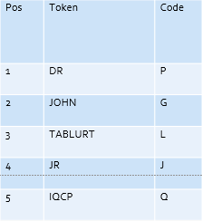
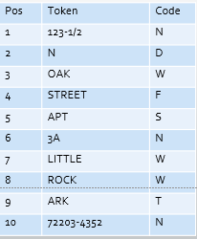
Name and Address Parsing
CONTENT:
Name and Address Parser Approach
Technologies Used
Steps in Name and Address Parsing
Step 1- Name and Address Parsing
What is Mask??
Example
Cleaning and Tokenizing
Getting the Tokens and Generating the Masks
Mask
Final Sub Step (Dictionaries)
Step 1 – Final
Step 2
Parsing
Now Suppose the Address and Name Was Split and Tokenized as Follows
Presented by:
Dr. Talburt’s Team
US Address Data Preparation Function (UAP)
09
Date- Apr. 26, 2022

Slide 10
Name and Address Parsing
CONTENT:
Name and Address Parser Approach
Technologies Used
Steps in Name and Address Parsing
Step 1- Name and Address Parsing
What is Mask??
Example
Cleaning and Tokenizing
Getting the Tokens and Generating the Masks
Mask
Final Sub Step (Dictionaries)
Step 1 – Final
Step 2
Parsing
Mask is the combination of the token codes with preserving the commas Like “NDWF,SN,WW,TN” is Address Mask
And “PGL,J,Q” is the Name Mask
Presented by:
Dr. Talburt’s Team
US Address Data Preparation Function (UAP)
10
Date- Apr. 26, 2022

Slide 11
Name and Address Parsing
CONTENT:
Name and Address Parser Approach
Technologies Used
Steps in Name and Address Parsing
Step 1- Name and Address Parsing
What is Mask??
Example
Cleaning and Tokenizing
Getting the Tokens and Generating the Masks
Mask
Final Sub Step (Dictionaries)
Step 1 – Final
Step 2
Parsing
Now Dictionaries are a key value pair of Mask as the key and Dictionary as the Value, for an instance
“NDWF,SN,WW,TN”{@USAD_SNO(1)|@USAD_SPR(2)|@USAD_SNM(3)|@USAD_SFX(4)|@USAD_ANM(5)|@USAD_ANO(6)|@USAD_CTY(7, 8)|@USAD_STA(9)|@USAD_ZIP(10) }
Presented by:
Dr. Talburt’s Team
US Address Data Preparation Function (UAP)
11
Date- Apr. 26, 2022

Slide 12
Name and Address Parsing
CONTENT:
Name and Address Parser Approach
Technologies Used
Steps in Name and Address Parsing
Step 1- Name and Address Parsing
What is Mask??
Example
Cleaning and Tokenizing
Getting the Tokens and Generating the Masks
Mask
Final Sub Step (Dictionaries)
Step 1 – Final
Step 2
Parsing
Now Suppose we get both the masks of name and address, then we submit then we enter the Buckets of the dictionary accordingly with the indexes given Like
USAD_SNO:[1], means that USAD_SNO’s token is 1 and the first token will go in this bucket (Same for name)
Presented by:
Dr. Talburt’s Team
US Address Data Preparation Function (UAP)
12
Date- Apr. 26, 2022

Slide 13
Name and Address Parsing
CONTENT:
Name and Address Parser Approach
Technologies Used
Steps in Name and Address Parsing
Step 1- Name and Address Parsing
What is Mask??
Example
Cleaning and Tokenizing
Getting the Tokens and Generating the Masks
Mask
Final Sub Step (Dictionaries)
Step 1 – Final
Step 2
Parsing
For Example If the Address is in this format
684|Mrs. Zachary Collins , Jr, QA, 12167 KATHERWOOD ST, SPRING HILL ,FL 34608
Then the output will be as
The Output Will Be
"Name": {
"Prefix Title": "MRS",
"Given Name": "ZACHARY",
"Surname": "COLLINS",
"Generational Suffix": "JR",
"Suffix Title": "QA"
},
"Address": { "USAD_SNO": "12167",
"USAD_SNM": "KATHERWOOD",
"USAD_SFX": "ST",
"USAD_CTY": "SPRING HILL",
"USAD_STA": "FL",
"USAD_ZIP": "34608"
}
Presented by:
Dr. Talburt’s Team
US Address Data Preparation Function (UAP)
12
Date- Apr. 26, 2022

Slide 14
Name and Address Parsing
CONTENT:
Name and Address Parser Approach
Technologies Used
Steps in Name and Address Parsing
Step 1- Name and Address Parsing
What is Mask??
Example
Cleaning and Tokenizing
Getting the Tokens and Generating the Masks
Mask
Final Sub Step (Dictionaries)
Step 1 – Final
Step 2
Parsing
Step 2 is very simple in which the Rejected masks with the tokens are then made into the Mask and Dictionaries by the User
Wherein with his knowledge he will enter the buckets corresponding to the addresses
Note:- In the future, the machine will replace the Human Involvement Using a Supervised Machine Learning Algorithm
Presented by:
Dr. Talburt’s Team
US Address Data Preparation Function (UAP)
13
Date- Apr. 26, 2022

Slide 15
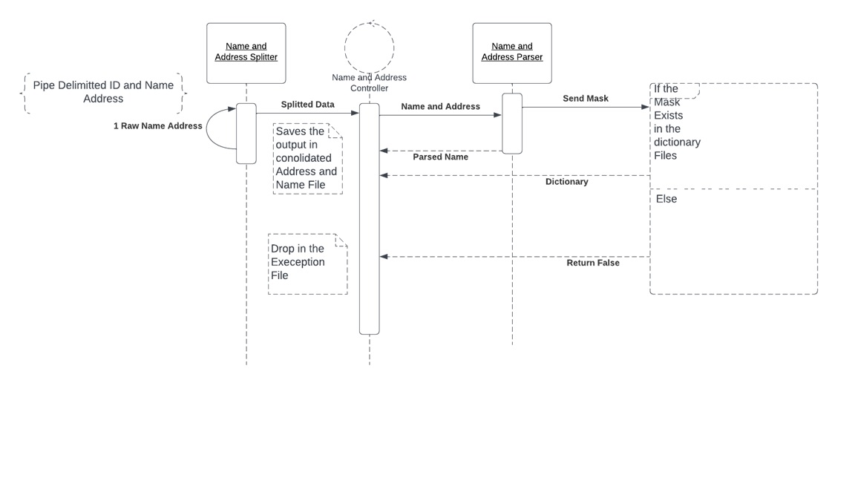
Name and Address Parsing
CONTENT:
Name and Address Parser Approach
Technologies Used
Steps in Name and Address Parsing
Step 1- Name and Address Parsing
What is Mask??
Example
Cleaning and Tokenizing
Getting the Tokens and Generating the Masks
Mask
Final Sub Step (Dictionaries)
Step 1 – Final
Step 2
Parsing
Presented by:
Dr. Talburt’s Team
US Address Data Preparation Function (UAP)
14
Date- Apr. 26, 2022

